Slide 1

Digital Notary System
Samiksha Deo 21104124
Sushant Mhatre 21104002
Siddhi Desale 21104135
Siddharth Devare 21104136
Project Guide
Mr. Mandar Ganjapurkar

Slide 2
Contents
Introduction
Objectives
Scope
Literature Survey (IEEE papers only)
Proposed System
Project Outcomes
Block Diagram
Use Case/DFD
Technology Stack

Slide 3
1. Introduction
1. Problem Identified:
Manual processes make notarization slow, costly, and error-prone.
Centralized storage is vulnerable to tampering and data breaches.
Physical presence limits accessibility and creates inefficiencies.
2. Solution Proposed :
Blockchain ensures decentralized, tamper-proof, and immutable document storage.
Smart contracts automate verification, reducing human error and delays.
Digital access removes the need for physical presence or paperwork.

Slide 4
2. Objectives
To develop a decentralized digital notary system using blockchain technology.
To ensure document integrity and authenticity through hashing and timestamping.
To enable secure access and verification of documents from any location at any time.
To implement smart contracts for automating verification and notarization workflows.

Slide 5
3. Scope
Can be verify the authenticity of documents using blockchain-based cryptographic hashes.
Can be provide a decentralized platform for notarizing digital documents securely.
Can be store immutable and time-stamped records on the blockchain for future reference.
Can be automate the notary process using smart contracts, reducing the need for interme- diaries.

Slide 6
4. Literature Survey
This foundational paper explores blockchain’s potential beyond cryptocurrency, emphasizing its capabilities for ensuring data immutability and transparency across areas like digital identity and record verification.
The authors propose a decentralized personal data management framework using blockchain, allowing secure sharing and verification of personal data without centralized control directly applicable to digital notary services.
This study introduces smart contracts to enforce and automate access control policies in IoT environments, showcasing how similar automation can be leveraged in blockchain based notarization systems.

Slide 7
5. Proposed System
1. Document Upload and Hashing
Users can upload any type of document (PDF, DOCX, etc.).
A cryptographic hash (e.g., SHA-256) is generated to represent the document’s digital fingerprint.
2. Blockchain-based Notarization
Document hash along with timestamp and user ID is stored on the blockchain.
Guarantees immutability and proof of existence.
3. Smart Contract Automation
Smart contracts automatically handle document verification and storage of hash.
4. Data Privacy
The actual document is never stored on the blockchain.
Only the hash is recorded, ensuring document confidentiality.

Slide 8
6. Algorithm used
Description about the algorithm you are using in your project.
Mention the dataset

Slide 9
6. Outcome of Project
Mentioned what will be the final output of project pointwise
e.g.
User Can log in
User can search for options available
Used can book ticket by providing following inputs
      -
And so on……

Slide 10
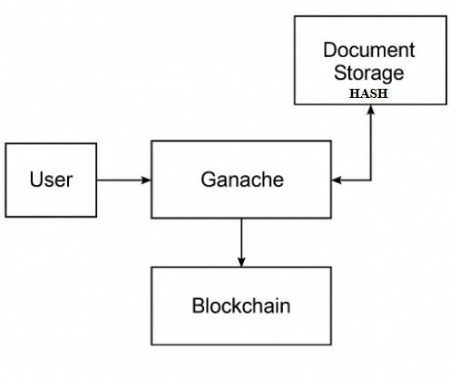
7. Block Diagram

Slide 11
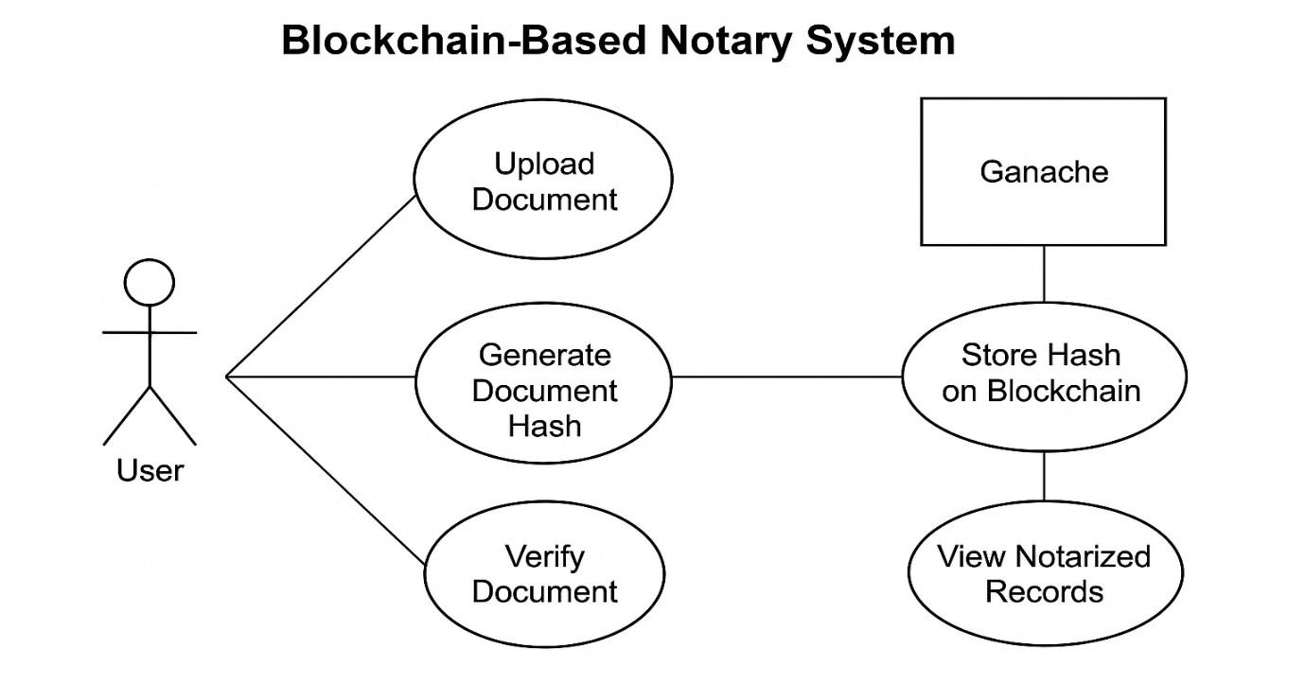
8. Use Case Diagram

Slide 12
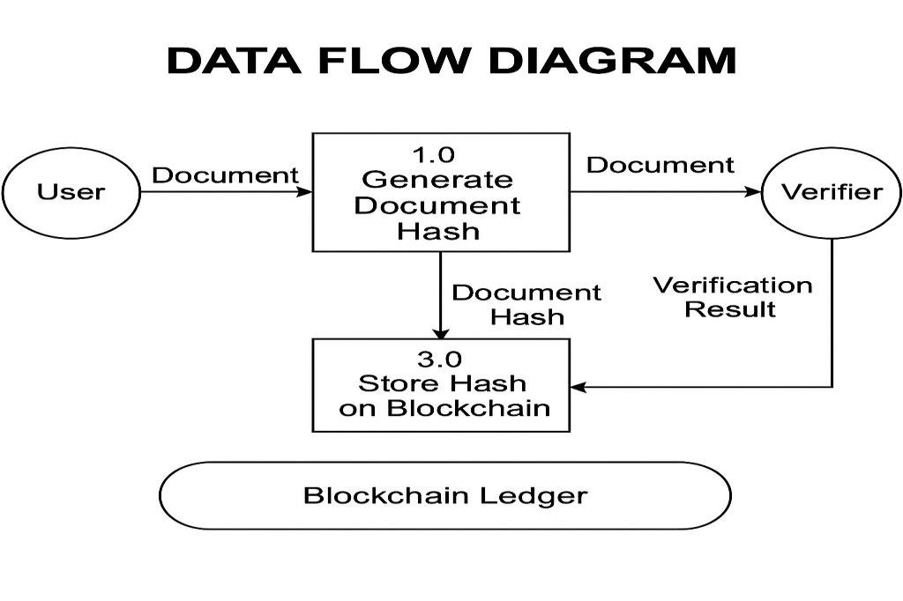
8. Use Case Diagram

Slide 13
9. Technology Stack
Blockchain: Hardhat, Solidity 0.8.20, Ethers.js
Frontend: HTML/CSS/JavaScript with Web3.js
Development: Node.js, npm, Ganache

Slide 14
Thank You...!!

